Slide 1
Suggested Approach for
Application of Waste to Energy (Mass Burn) for
Municipal Solid Waste Management at Pune
Presentation to
Shri Kunal Kumar, IAS
Municipal Commissioner
Pune Municipal Corporation
by
Dr. Dilip Boralkar
Ex-Member Secretary, Maharashtra Pollution Control Board
Pune
26th March, 2015

Slide 2
Scenario at Pune (2000TPD)
High Court, NGT Directions, Public Agitation
Environ. Degradation and Public Health Issues
Inefficient Performance of Existing Projects due to:
Low Tipping Fee
Impractical Commitments
Financial Unviability
Lack of Application of Knowledge in Planning & Project Management
Passive Approach in Implementation of Environmental Regulations
Inadequate Political Will and
Lack of Primary Importance to Environ. Protection.

Slide 3
What we Need
100% Compliance of Environmental Regulations
100% Protection of Public Health & Hygiene
Minimum Land Requirement
Minimum cost on Citizens
Project Subsidy for Reduced Tariff
Asset’s Life 20 years with payback in 7 years
Recovery of Subsidy & Reduced Tariff after 7 yrs.
Corporate Guarantee from vendor

Slide 4
Way Forward
Application of Waste to Energy based on Mass Burning (even without segregation) using reciprocating grate technology capable of operating low calorific value of MSW
Technology is environmentally sound, time tested, & successfully operating about 1600 plants in cities across the world.

Slide 5
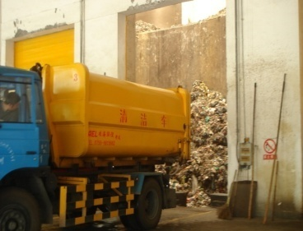
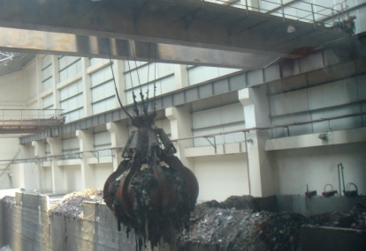
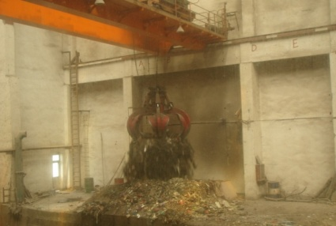

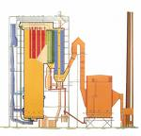
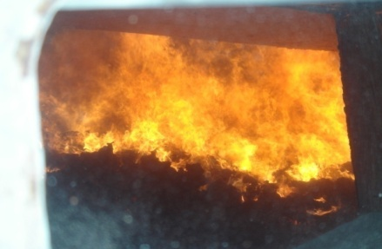
MSW To Energy Process Flow
Combustible Waste Receiving
Lifting with Grab Crane
Combustible Waste Feeding into Hopper
Power Generation & Transmission
Steam Generation
Combustion

Slide 6

Design for Low Cal Waste Burn (illustrated)
The flue gas stays at least 2 seconds in the first flue and hearth while the temperature is higher than 850 degree. Thus, the dioxins could be effectively removed in this way.
The combustion temperature is below 1050⁰C to maximally control the generation of NOx.
The form of hearth: no water cooling, the refractory brick is set in the combustion chamber
Four independent combustion air control zone in this direction.
Increased length of fire grate and rear arch to make rubbish fully burnt and reduce mechanical load and heat load of furnace grate
Heat the primary combustion air and secondary combustion air, the lowest temperature is 220⁰C .

Slide 7
Project Proposal
Capacity : 2x600 TPD
Type of waste : Mixed waste
Calorific Value : 1100 to 2200kcal/kg
Technology : Mass Burning (Grate Technology)
Furnace : Grate Furnace
Flue gas treat. : Evaporation cooler /semidry, Bag Filter
Electrical power : 2 x 11.5MW
Land required : 2 x 5 Acres for 2 units
+ 5 Acres for Landscape

Slide 8
Business Model for Pune
Capital & Operational Cost:
Capital cost for 2x600 TPD MSW mass burning with grate technology plant is estimated @ Rs.292 Cr + subsidy Rs.100 Cr = Rs.392 Cr.
Rs. 2700/MT is the total cost of operations including interest, depreciation, manpower. This is equal to Rs.104 Cr. /year
Rs. 2000/MT can be recovered from sale of power at Rs. 5.8/Unit. This is equal to Rs. 77 Cr/year
Rs. 30/family/per month (12 lac families) levy will yield revenue of Rs. 44 Cr.
Hence, Rs. 17 Cr will be surplus after (C+D)-B
Therefore, subsidy will be recovered in first 6 years. PMC will save Rs.22Cr per year which is being spent today @ Rs.700/MT for 1000 MT/day of MSW.

Slide 9
Modified PPP Model
“Modified PPP” model proposed with capital grant of Rs. 100Cr. from the client Local Body and/or Government
Operator to arrange rest of the finance for capital investment and operation & Maintenance for 7 years
Transfer of Assets to PMC after 7 years
Expected life of 20 years for the assets created

Slide 10
Operator’s Liability
Processing and disposal of 1200 TPD MSW and generate minimum 20 MW (24-hr average) electricity.
Operator to submit corporate bank guarantee as proof of feasibility of technology to generate committed quantity of power.
Plant life shall be at least 20 years and operator shall operate and maintain plant for minimum period of 7 years. This can be extended thereafter based on mutual agreement.
MSW processing and disposal cost of waste works out to be average Rs. 2700 per MT.

Slide 11
Support Required from PMC/Govt. (1)
Provide 1200TPD mixed waste at site.
Grant Rs.100Cr as subsidy for project
Pay MSW processing and disposal cost @ Rs. 2700/MT
Establish its own or hire power grid transmission system so as evacuate electricity generated at the facility by the Operator.
Utilize power for own purpose or Sale to other users. This means PPA is not in the scope of the operator.
In case the energy/power tariff is @ Rs.5.80 per unit as prevailing today, Rs. 2000 per MT can be recovered by the PMC/Govt. from the sale of energy.

Slide 12
Support Required from PMC/Govt.(2)
Rs.700 per MT can be recovered from public by levying MSW P&D charges @ Rs. 30 per month per family from the 12 Lacs families in Pune city.
Fast track system to be established for timely payment of P&D charges to the operator through an escrow account.
Regular monitoring of plant operations in terms of power generation, efficient operation & maintenance and compliance of environmental and other regulations.

Slide 13
Benefits of Waste to Energy
90% DRE : 500 MT of MSW will become 50 MT inert ash in 24 hrs.
Bottom ash for RMC, Bricks etc.
Fly ash disposal in SLF
Best Available Technology (BAT): Maximum Resource Recovery
Minimum waste re-handling for better ensuring health & safety
Fully automatic process
No odour, No smell, No fly/mosquito menace
100% Compliance of Environmental regulations.
No ground water contamination.
Not Land-intensive
Customised for India due to its un-segregated low calorific value waste
EST and ESM in place.

Slide 14
ROAD MAP
Step 1: Appoint High Powered Expert Committee for Transaction of Application of W2E (Mass Burn) for Management of MSW at Pune. (Action: Immediate)
Step 2: Engage Expert Agency for Preparation of DPR and Draft RFQ and RFP ( Action: 3 months)
Step 3: Engage Transaction Advisory for Procurement of Operator. (Action 4 months)
Step 4: Agreement between PMC and Operator and Appointment of Independent Engineer for Project Implementation (Action: 1 month)
Step 5: Project Implementation (10 months)
High Powered Committee to coordinate, supervise and recommend actions regarding project implementation.

Slide 15
For Smarter Cities we need:
Smarter Politicians
Smarter Bureaucrats and
Smarter Citizens
-India Today, Dec.,1, 2014
Thanks
Dr. Dilip Boralkar
www.boralkar.com

Slide 16
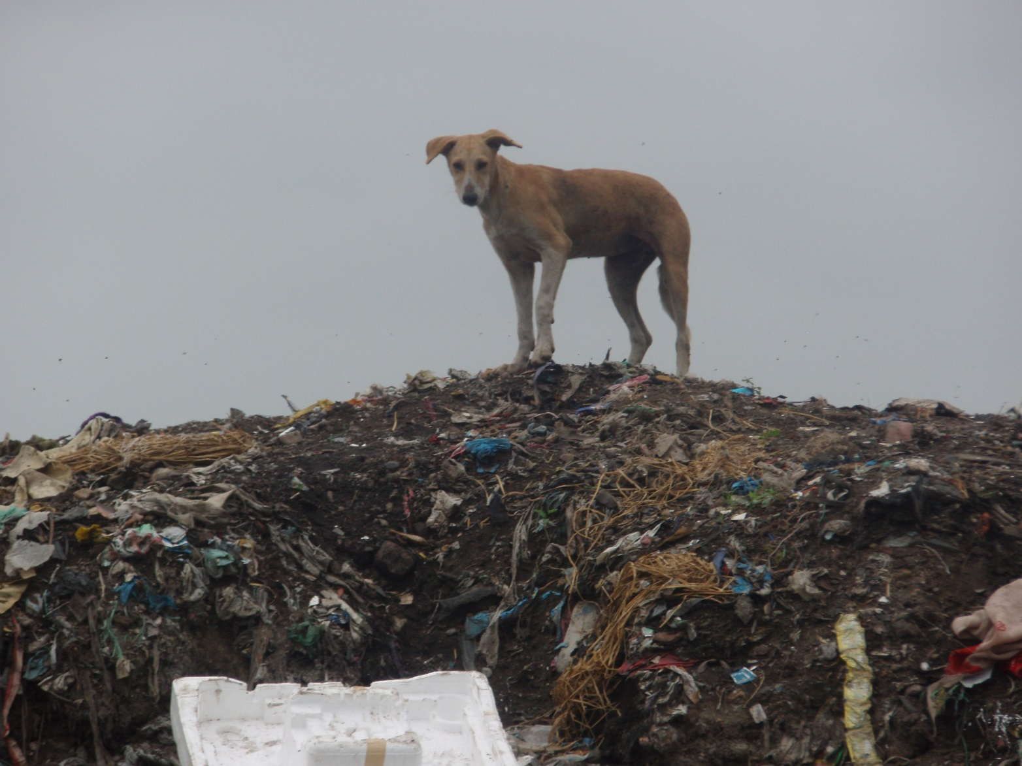
Support Presentation

Slide 17
Pollution Mitigation
Semi dry Flue gas system consists of
Reaction tower,
Lime slurry making system,
high speed atomizer,
Bag filter and stack .
Removal of acidic components in the flue gas by injection of hydrated lime
The flue gas is further treated by injecting Activated carbon for reducing Dioxins /Furans levels to < 0.1mg/Nm3.
Online environmental monitoring

Slide 18
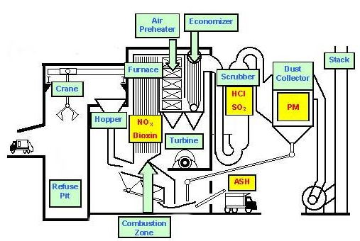
Emission Control

Slide 19
Stack Emission Standards
Parameter | Environmental Regulations in India
Particulate matter | 30 mg/Nm³
Sulphur Dioxide (SO2) | 100 mg/Nm³
Oxides of Nitrogen (Nox) | 350 mg/Nm³
Hydrochloric Acid (HCl) | 50 mg/Nm³
Dioxins & Furans | 0.1 ng/Nm³ TEQ
Carbon Monoxide (CO) | 100 mg/Nm³
Cadmium (Cd) | 0.1 mg/Nm³
Lead (Pb) | 0.1 mg/Nm³
Mercury (Hg) | 0.02 mg/Nm³
Hydrofluoric Acid (HF) | 0.5 mg/Nm³
Stack Height | Minimum 30m

